Slide 1
MINOR PROJECT II
PROBLEM STATEMENT:
To create a pandemic analyzer calculator
SUBMITTED BY:
Ritul Mukherjee

Slide 2
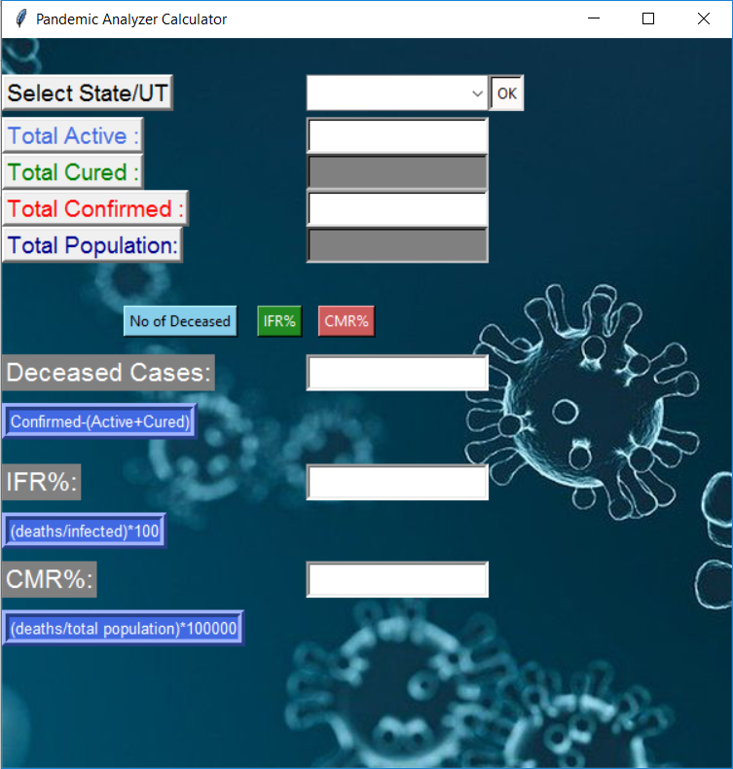
SNIPPETS OF PANDEMIC ANALYZER CALCULATOR
Drop down list to select states
Information regarding patients and population is displayed here
Clicking these buttons will provide no of deceased patients as well as CMR and IFR of the selected state
Results are shown here after clicking above buttons

Slide 3
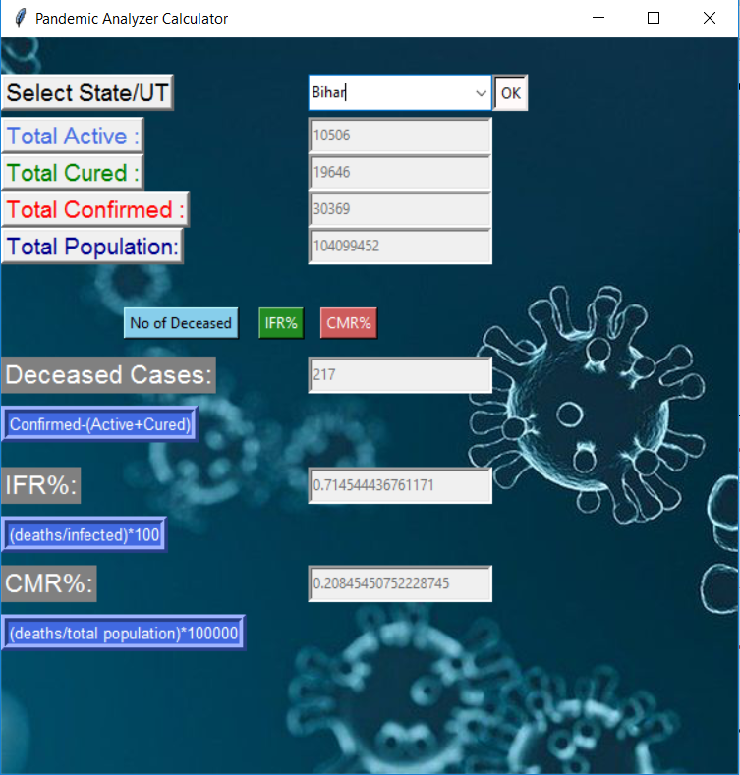
SAMPLE OUTPUT
Resources:
https://www.mohfw.gov.in/
https://en.wikipedia.org/wiki/List_of_states_and_union_territories_of_India_by_population

